Slide 1
The library image and you
Dr. Curtis Rogers, Communications Director

Slide 2
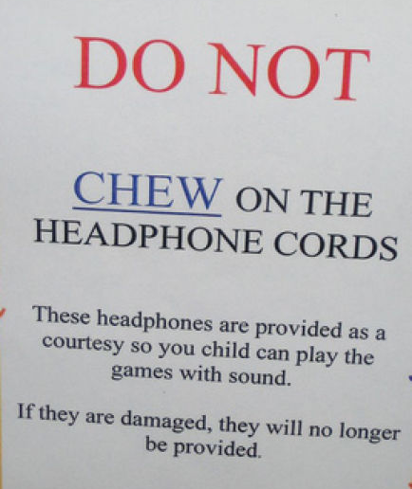
Talking points
My Presentation Style
The Library Image Audit
Library Signage
Library Brand Recognition
Customer Service
POSITIVE Messages

Slide 3
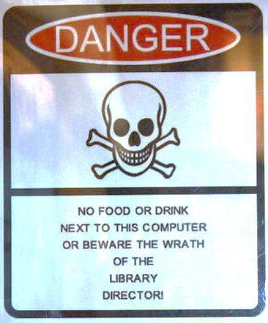
Conduct a library image audit
1. know your library’s mission, vision, taglines, etc.
2. conduct a signage audit
3. ask a friend or family member to visit the library
4. develop a committee if needed
5. present your findings

Slide 4
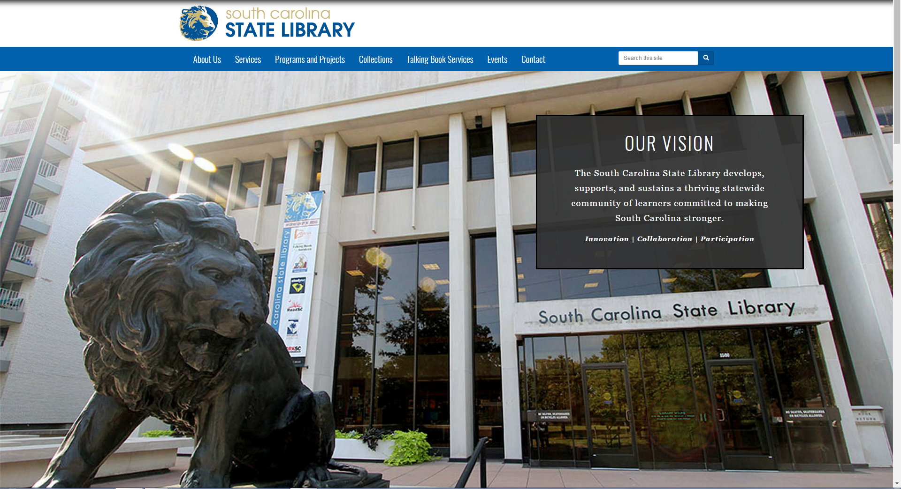

Slide 5
Components of a library sign
positive
negative
Polite language
Not verbose – get to the point
Use library logo/branding
No typos
Correct grammar
Font and font size
Image that supports content
Handwritten
Too many words
Clip art – just. don’t. do. it.
Comic sans font (another no no)
Passive aggressive
Too many colors
Too much going on

Slide 6
Let’s do the plus delta…
What is good?
What would you change?

Slide 7
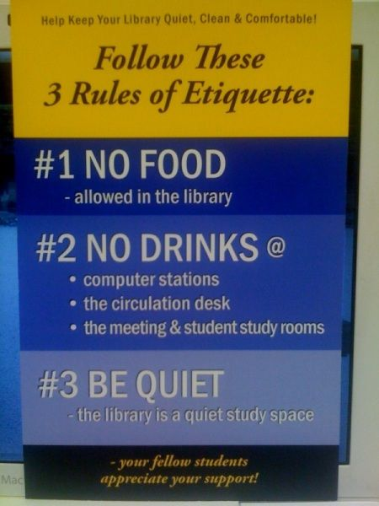

Slide 8
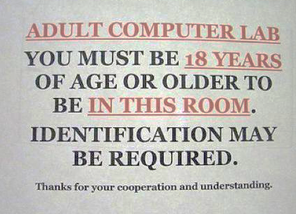

Slide 10
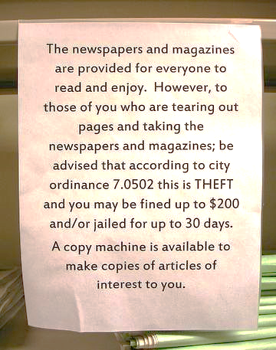

Slide 11
The library image audit
Why do this?
How do I do this?

Slide 12
A library image audit is an audit of the library’s internal and external image including printed materials, signs, customer service, grounds, and community perceptions.

Slide 13
Outside of building
Is the shrubbery or grass maintained?
Are there areas flower beds could be created? If beds are there, are they maintained regularly?
Are the signs for the library in good condition? Are they large enough? Do they need repainting? Do they need to be lighted?
Is there trash on the grounds? Are attractive trash containers available? Are containers available outside for smokers to extinguish cigarettes?
Is visitor parking prominently marked and plentiful?
Is the entrance to the building clearly marked?
Where are other directional signs to the library located in the community? Are the directions well marked and easy to understand?
Is this a building you would be proud to bring friends and family to?

Slide 14
Inside of building
What does someone see when they first enter the building?
Where is the information desk? Is it well marked with signs? Is it cluttered or neat? Is it staffed at all times?
Is there a place such as a bulletin board to post special information? Is it attractively displayed? Is everything current? Is it regularly cleaned?
Are the hours of operation posted clearly?
Are all areas of the library kept neat with books, magazines and other materials shelved or attractively arranged. Is the furniture in good condition?
Are the floors or carpet cleaned frequently?
Are trash containers strategically placed throughout the library?
Are restrooms clearly marked and kept clean?
Would you be proud to bring a family member or close friend to the library?

Slide 15
Other important items
How is the library listed in a Google search?
Do key points of contact such as the Chamber of Commerce, city hall, schools, and local service stations know where your library is?
Are library directional signs on well-traveled roads? Are the directions clear to someone unfamiliar with the area?
What do you do to help patrons with special needs? Do you know what services are available for patrons with special needs?
Are the specific areas of the library easy to reach and well marked?
Do all patrons, regardless of needs or reasons for visiting the library, feel welcome?
Does the staff understand the importance of good customer service to the library?
Does the staff understand the role they play in developing and maintaining a positive image for the library?
Is customer service regularly promoted to the staff?

Slide 16
Other important items, continued
How attractive and inviting are the information desk, bulletin board, stacks, reading area, magazines, offices?
Is staff dressed neatly? Is there a dress code and is it followed? Do you have dress-down day? Do patrons know this? Does the staff know what is acceptable and not for dress down?
Is the staff knowledgeable about their specific area as well as the library in general?
Do they respond promptly and courteously to requests?
Do they speak positively about the library and promote its services to civic, church and business groups?
Graphic and Printed Materials:
Do you have letterhead and envelopes for the library?
Does the staff have business cards?
Do your printed materials have a special format? Do you have special colors for certain program areas or publications?
Does the staff know the library’s policies on printed materials, such as who approves printed pieces? Is there a review of all printed materials before they are finalized?
Are signs in the library easily read? Are they neatly done? Can patrons with special needs read them?
Are printed materials grammatically correct and spell checked?
Does the library have a recognizable logo?
Is it current and does it reflect the image you want of your library? Are there guidelines for use of the logo?
Is there a style guide for the library?

Slide 17
Present your findings
Use signage audit photos.
Show the before and after.

Slide 18
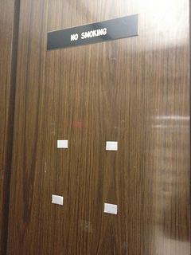
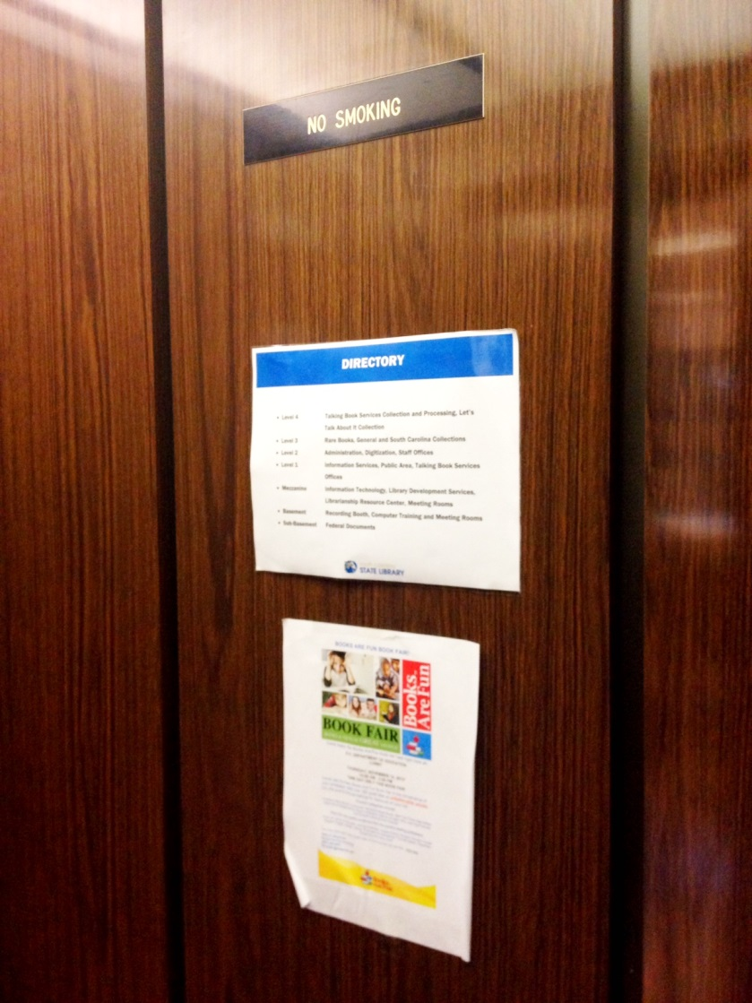
Before and after

Slide 19
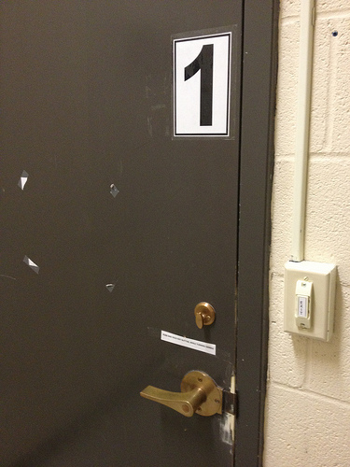

Slide 20
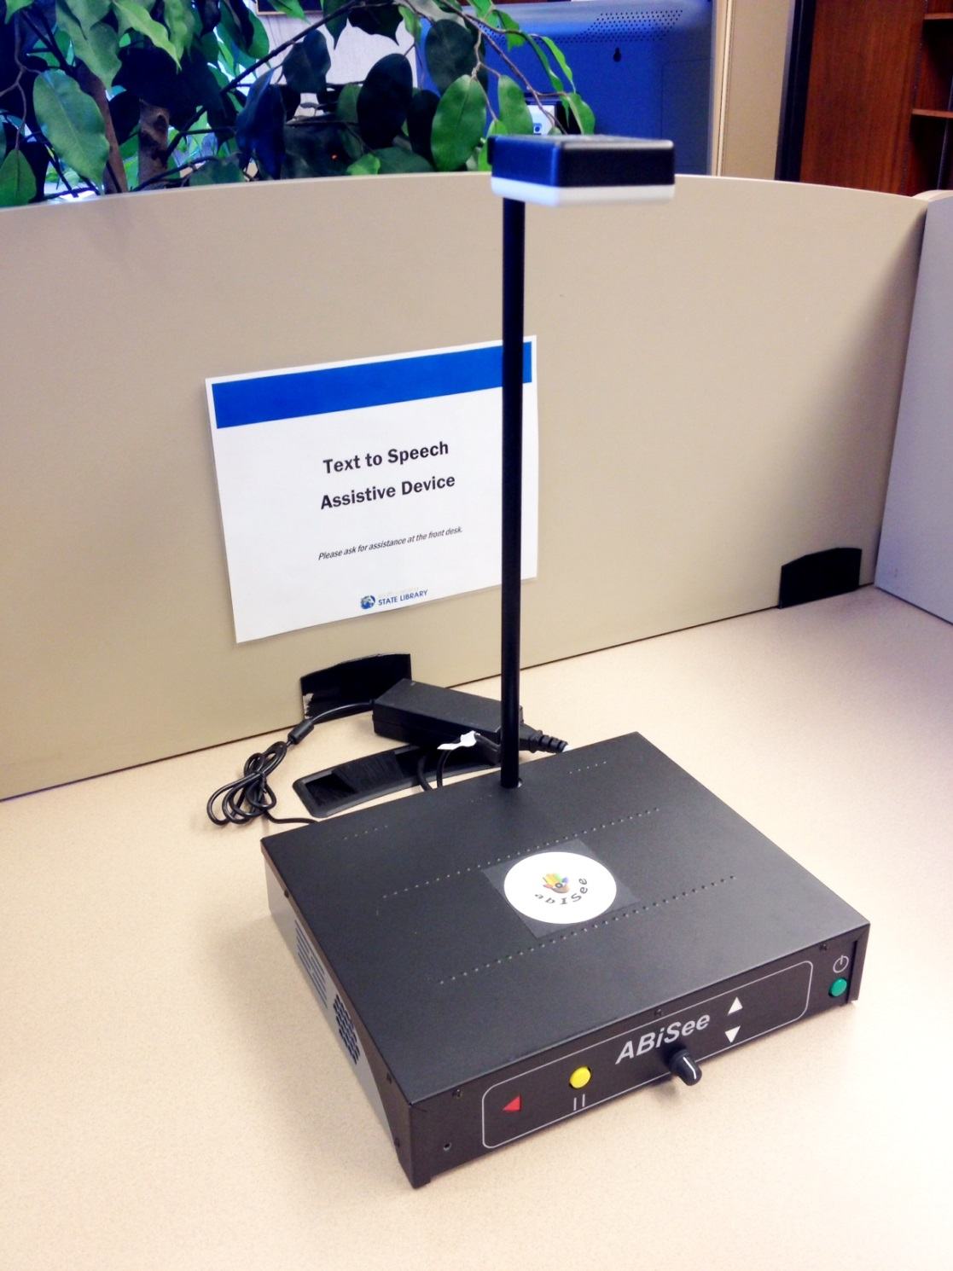
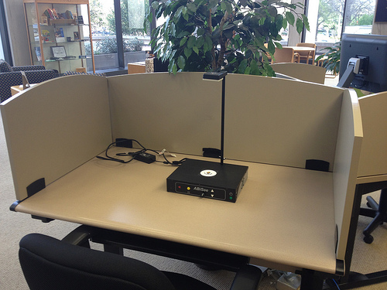

Slide 21
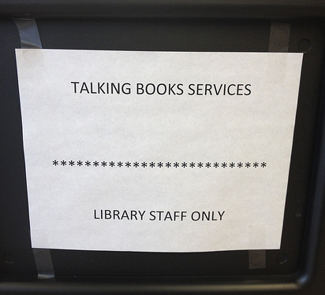
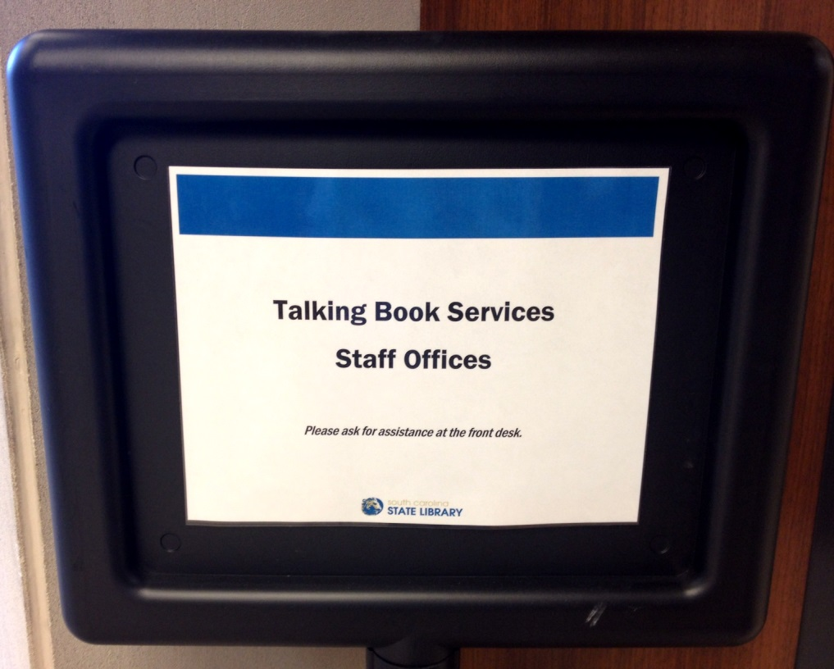

Slide 22
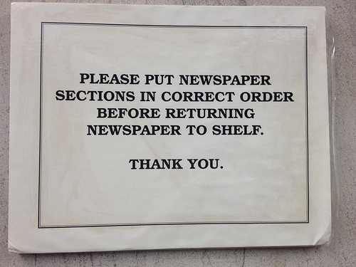

Slide 24
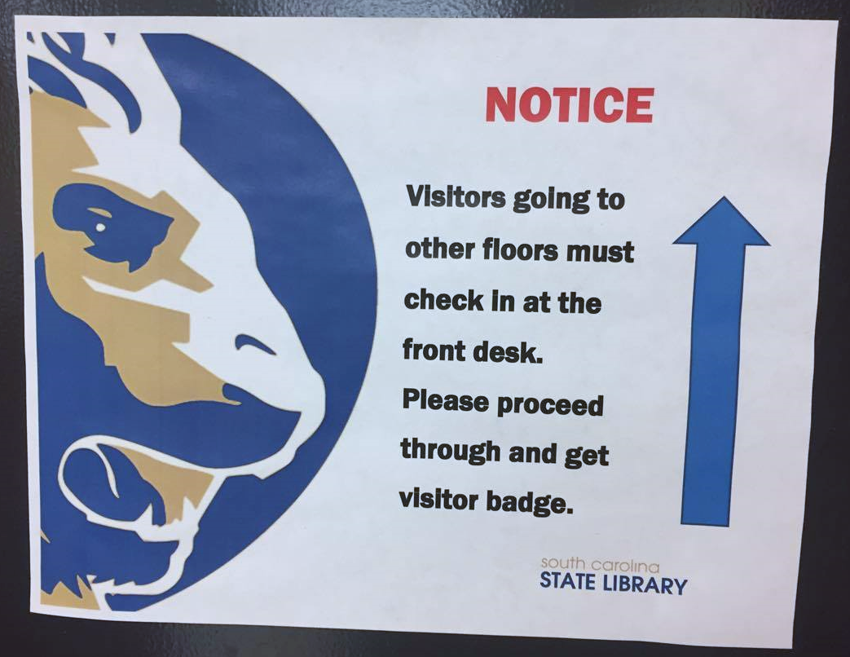

Slide 25
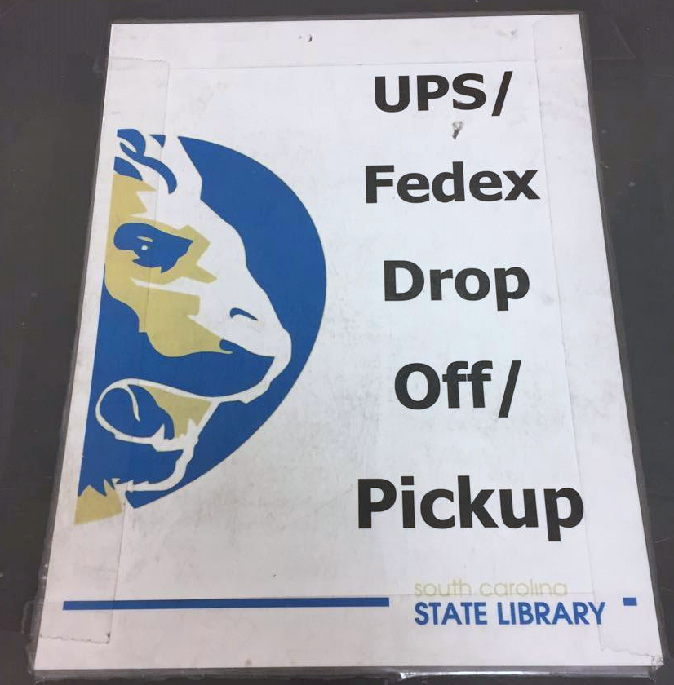

Slide 26
And remember to
Establish a signage committee if needed
Educate staff at meetings
Appoint signage contact(s)
Post templates to intranet
Keep current (signage evolves)
Create templates
Use controlled vocabulary
Include your library’s logo
Decide on set colors
Decide on a font family
Make sure library leadership is on board

Slide 27
Additional resources
for making your library a better place!

Slide 28
Flickr
https://www.flickr.com/groups/librarysignage/
Pinterest
https://www.pinterest.com/harrietlatessa/library-signs/?lp=true
PRTalk Listserv
The Accidental Library Marketer
The Customer-Focused Library: Re-Inventing the Public Library From the Outside-In

Slide 29
Thank you! Feel free to contact me
Dr. Curtis R. Rogers,
Communications Director
803-734-8928
crogers@statelibrary.sc.gov

